Slide 1
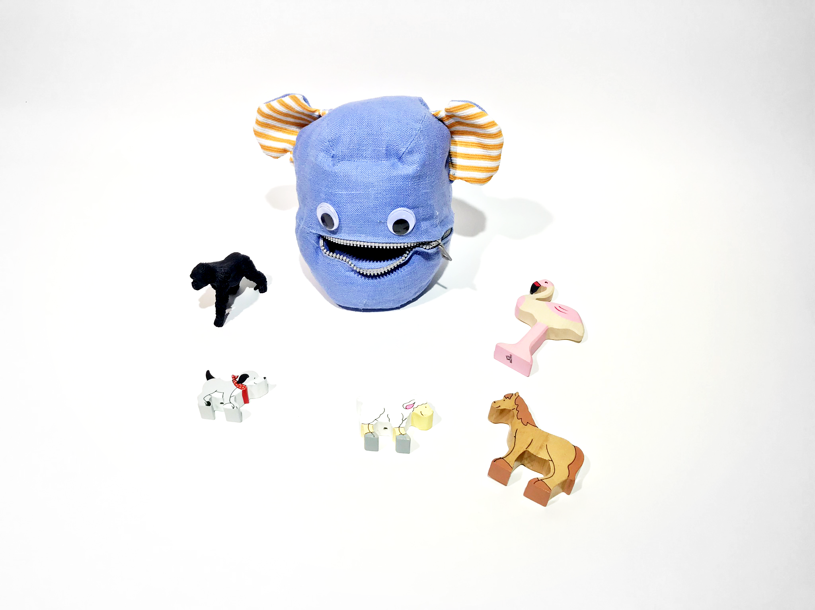
Talki
Learning Languages through play in early childhood
Caterine Apruzzese
Master of Advanced Studies in Interaction Design

Slide 2
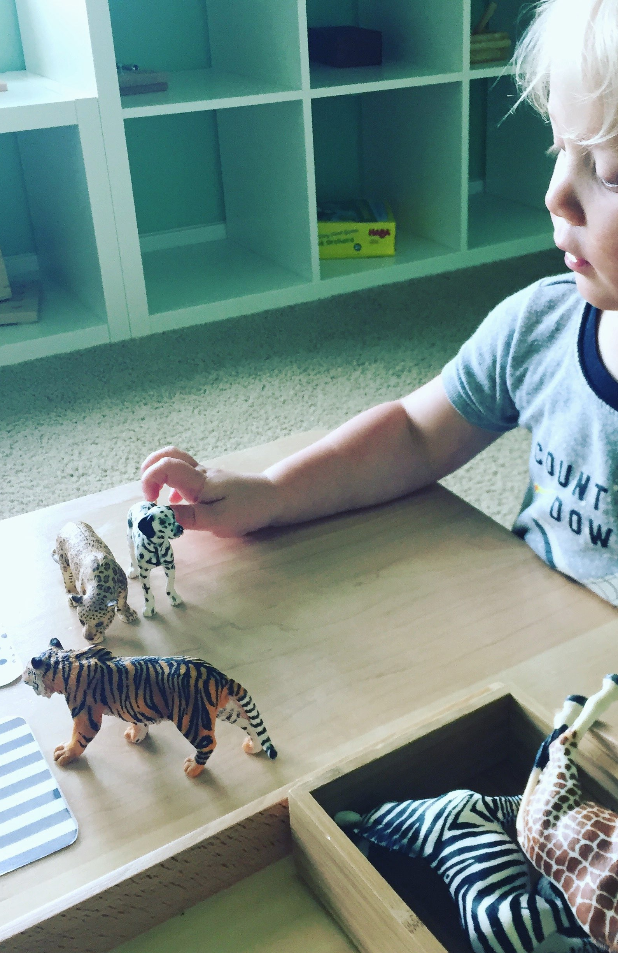
Research questions
How might we create an engaging multi-sensory experience that allows for maximum movement and free play in language learning?
How might we create an engaging and playful interactive alternative to touch screen based solutions for training spoken language?

Slide 3


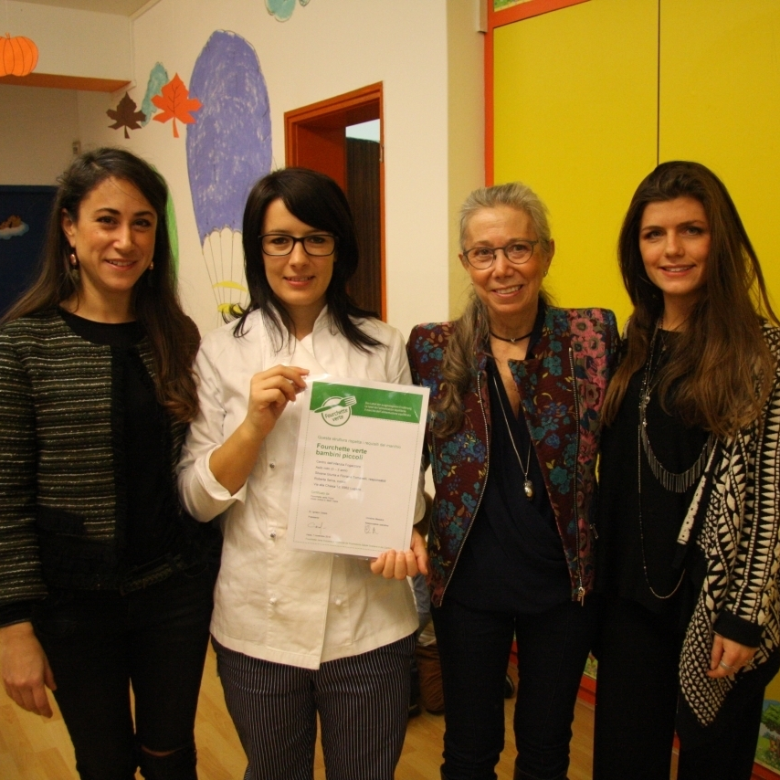
Interviews to Montessori Kindergarden Teachers
I’ve interviewed experienced teachers and headmasters to gather domain knowledge from the point of view of the users, who are primarily children but also parents. We want to learn more about what toys or things kindergarden and pre-school children play with to support learning, how, where and who with.
Barbara Weiss
Anna Flückiger
Silvana Giunta
Head of Kindergarten in Zug
Owner at Montessori Schule Lenzburg
Director at Casa dell’Infanzia Fogazzaro Lugano
2

Slide 4
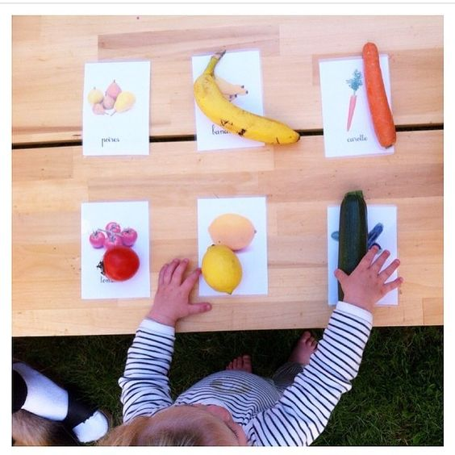
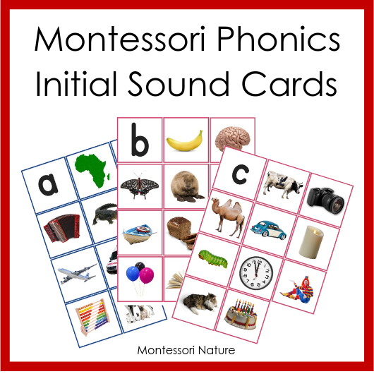
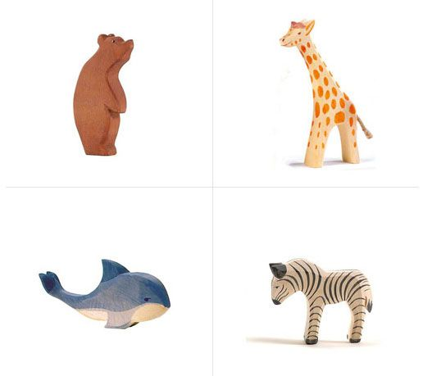
Interview Insights & Educator Quotes
“Children can learn complex topics at the age of 3 or 4. They can learn complex concepts such as trigonometry and meditation.”
“Material used to support learning: Cards with printed illustrations and text. 3D wood figurines, puzzles, world globe, maps, shapes to teach them different ways to hold a pen with both hands.
Children love to play with small things”

Slide 5
“No rewards, no praise…The motivation must be intrinsic… children are naturally curious to learn new things and the motivation must come from them, or the child has psychological problems”
“No pressure. Let them take their time to finish the exercise and figure out for themselves if the exercise is correct”
“We don’t correct mistakes. We just record that the lesson needs to be repeated so the child learns the right answer.”

Slide 6
“Children learn better if they have something in front of them that they can physically feel and touch. Using many senses makes learning to be more effective and meaningful”
“Every child is different…Children grow and develop at different rates in different areas. They develop at their own pace and in their own way”
“Children start listening before they start speaking. Language is about communication and children will know when is the right time for them to use the words they have encountered or speak in full sentences. No pressure, it will come naturally”

Slide 7
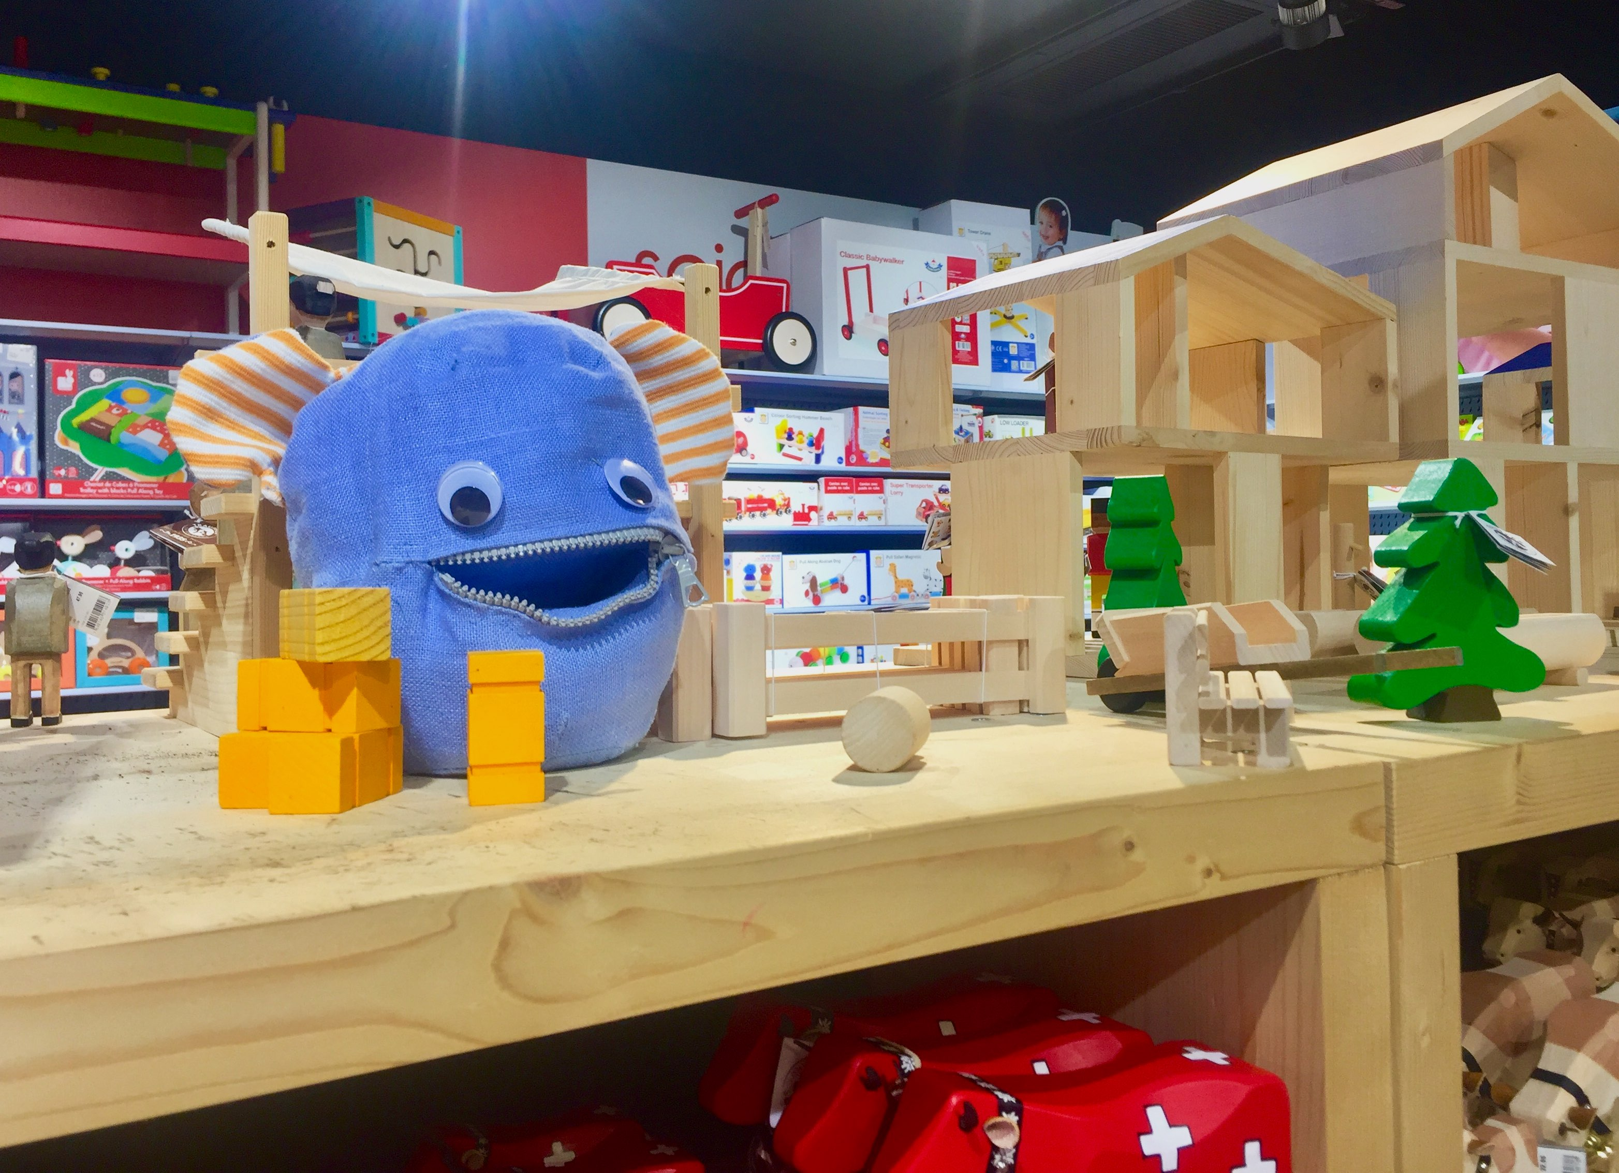
Concept
Talki the seeing and speaking monster

Slide 8
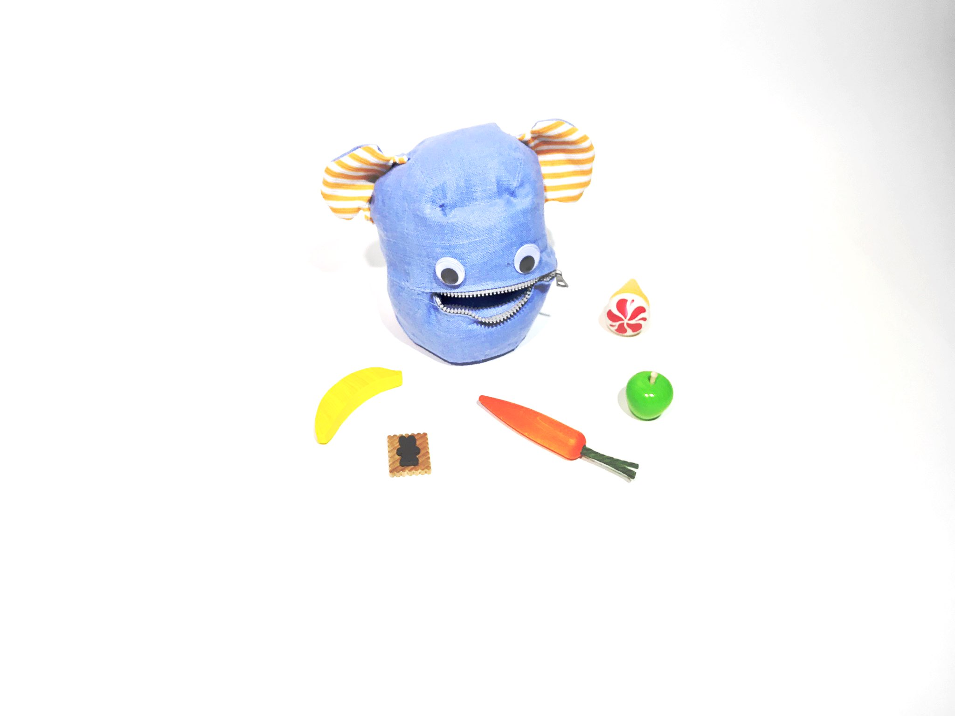
Who is Talki?
Talki is an interactive educational toy that teaches children aged 3-6 years old an additional language.
Talki speaks in full sentences, just like a mother speaks to a toddler
It can see but it can’t hear and speaks to a child based on the known objects it sees and the child shows it
Talki encourages multi- sensory learning by engaging the child in auditory, visual and kinaesthetic play

Slide 9
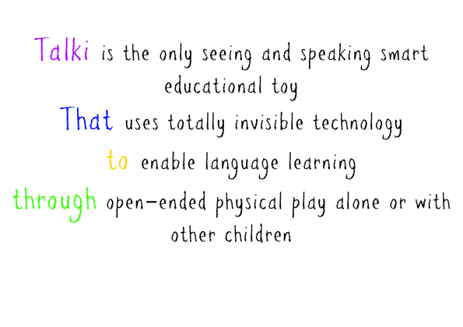

Slide 10
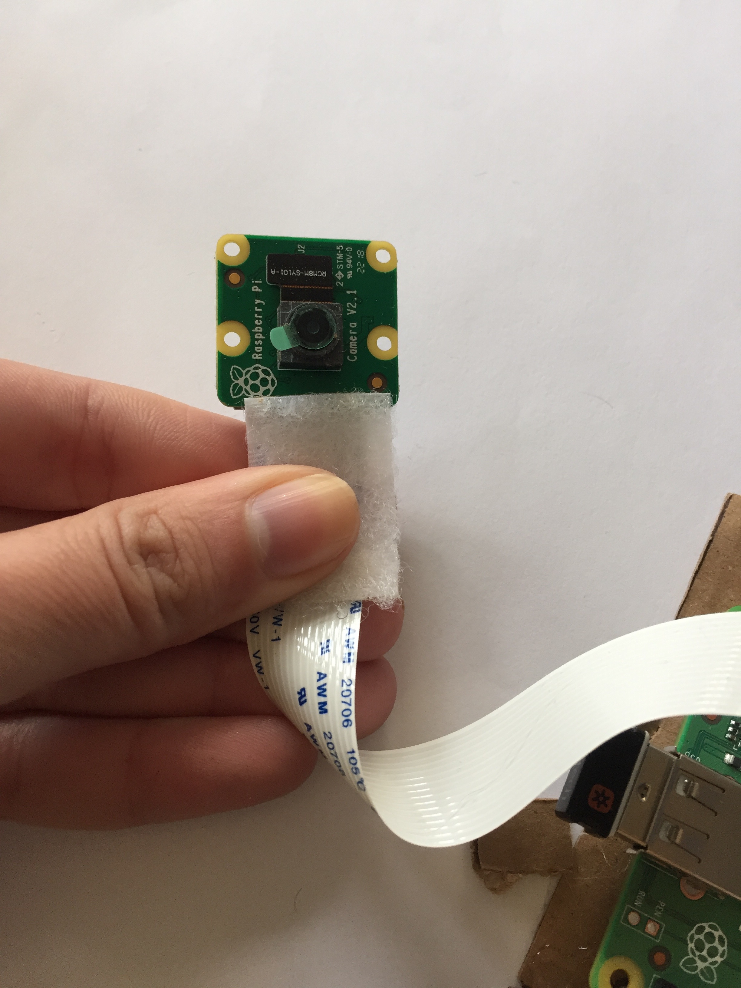
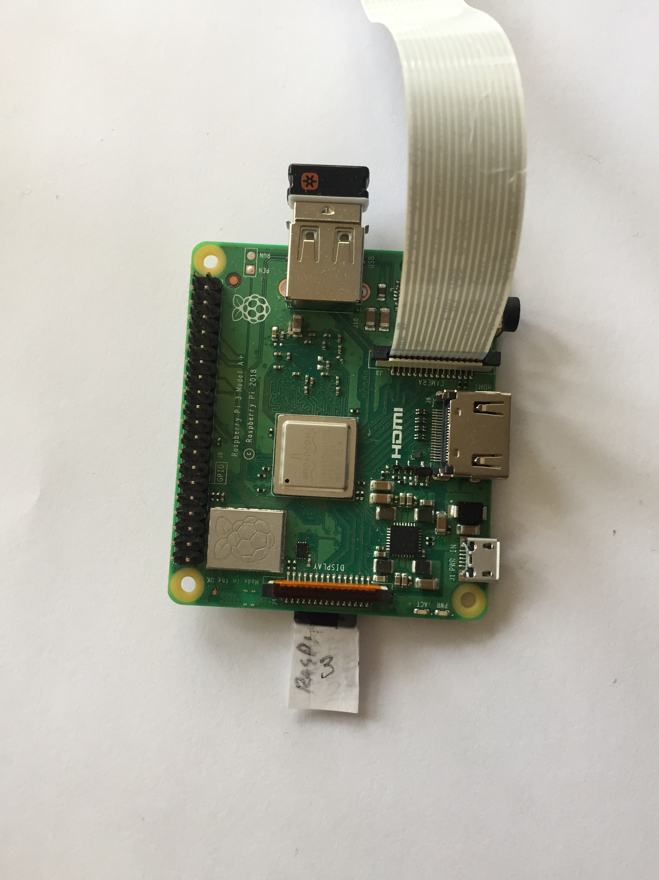
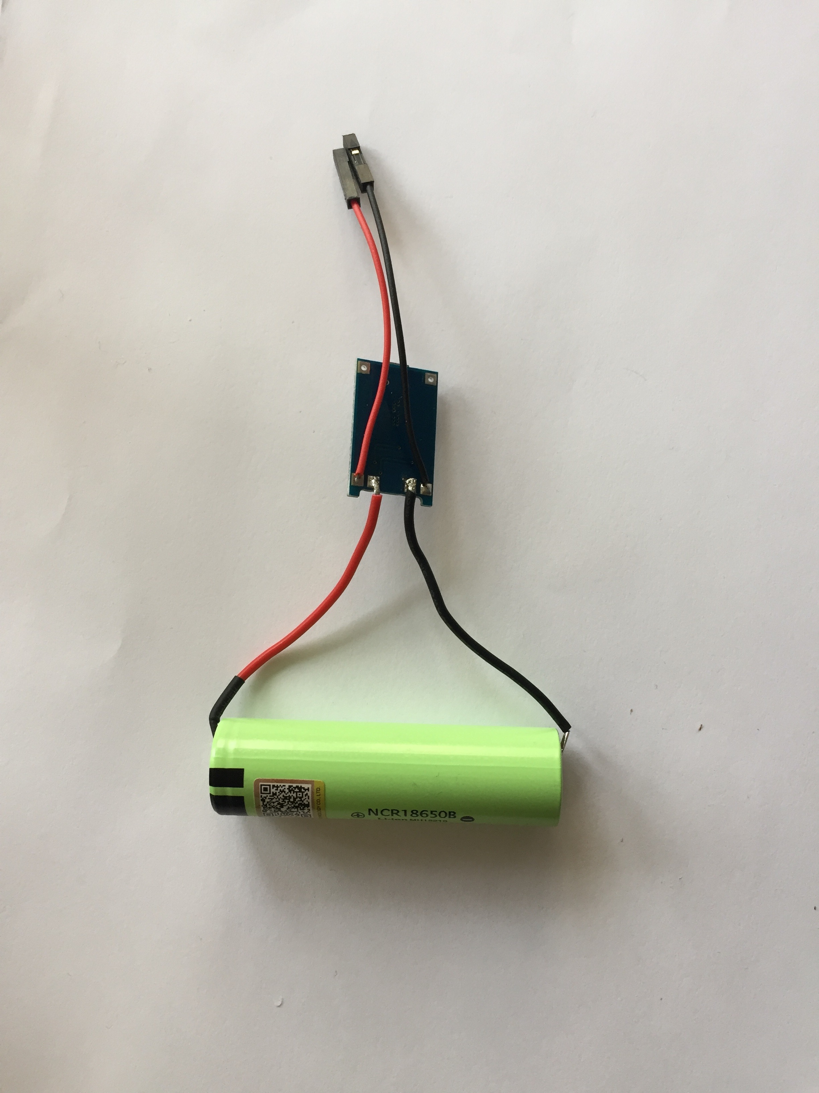
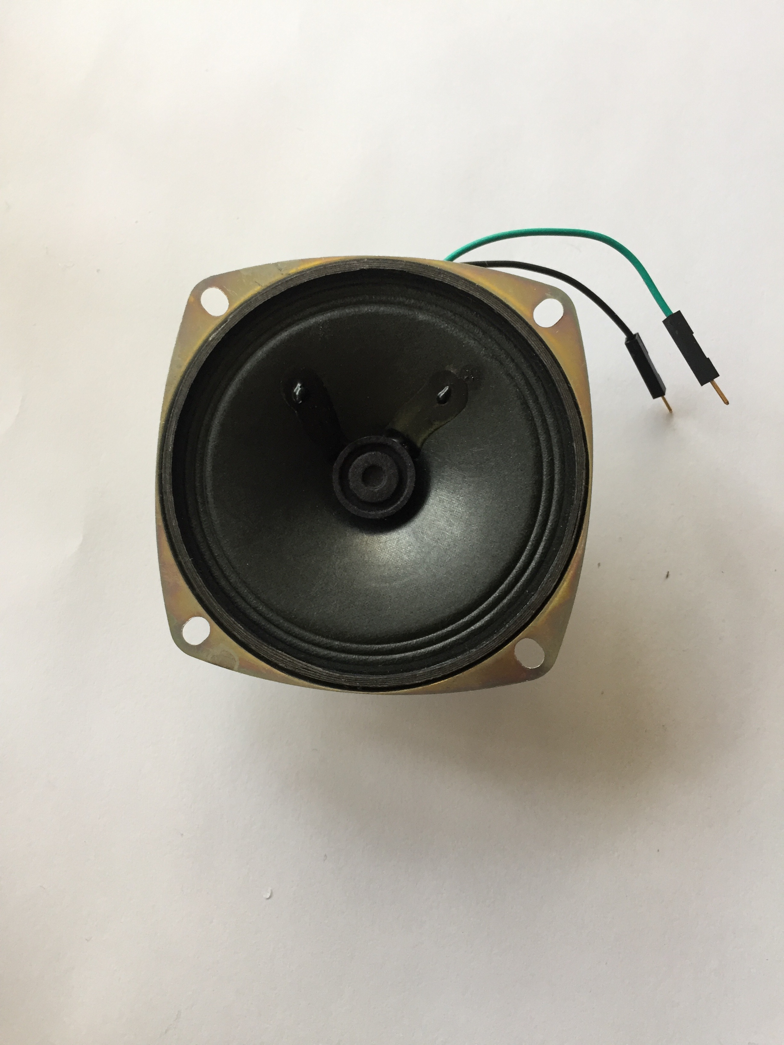
What is Talki made of?
Talki uses computer vision/machine learning to recognise objects it sees
It uses no screens, or any other interfaces associated to digital devices
Camera
Raspberry Pi 3A +
Battery
Loudspeaker

Slide 11
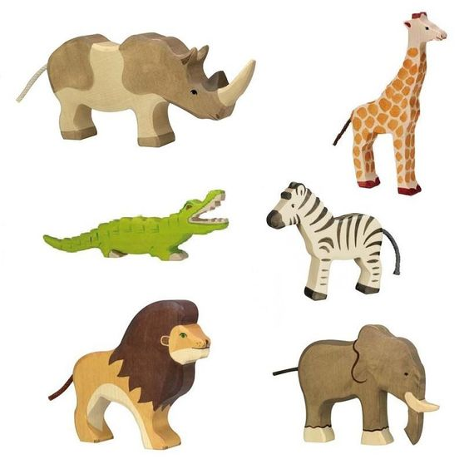
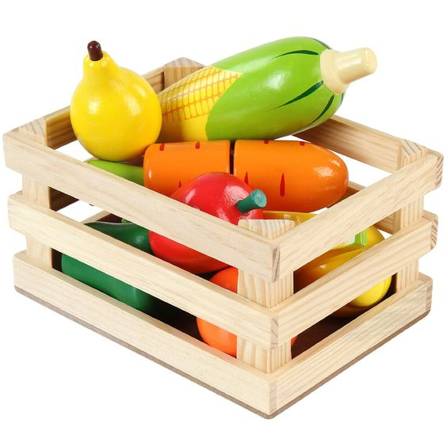
What things does it recognise?
It recognises wooden and figurine toys that are part of a toy set for teaching everyday vocabulary related to different topics such as food, animals, public transport, things in nature, etc. It also recognises colors e.g a green apple and shapes

Slide 12
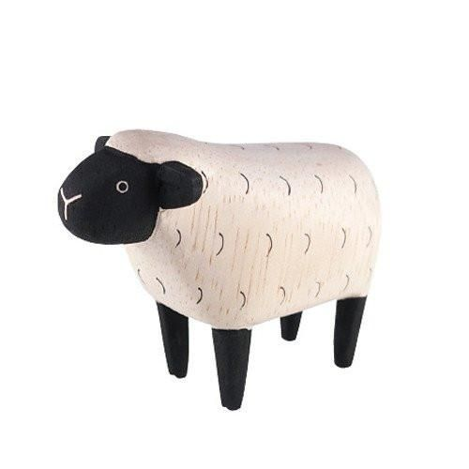
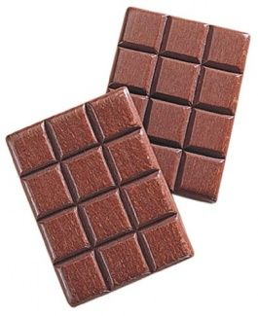
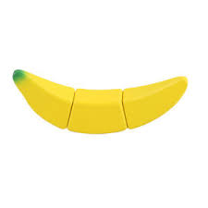
What skills does Talki train?
The goal of Talki is not that the child becomes fluent in a language. It trains phonological awareness, the ability to hear and recognise the sounds within words. It trains the child’s ears to the sounds, rhythm, flow and pronunciation of words in a spoken language.
It’s a listening and pre-reading skill (before children can read and write)
Chhh or choc
bbbbbb
Shhhh

Slide 13

What is the main benefit of Talki?
Listening to the correct pronunciation of words from a secondary language. Listening to the sounds within words
Most grown ups never achieve to speak a second language with a native accent, although they may be fluent. In most cases that’s because we were told to memorise lists of words, without sound practice…
After the age 8 years old is too late to train towards fluent listening and speaking

Slide 14
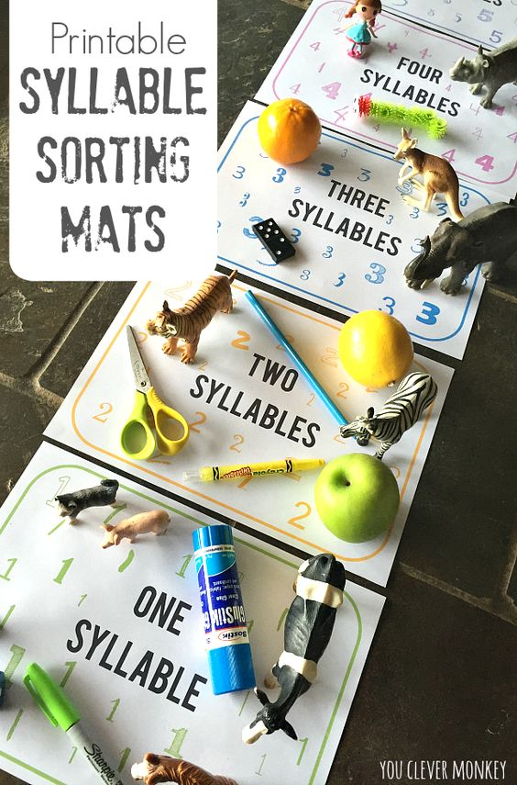
Talki’s Learning Goals
To teach phonological awareness
Rhyming
Identifying syllables
Intonation
Recognition and pronunciation of 28 phonemes. There are approx 44 sounds in English language
To teach vocabulary:
34 animals and things in nature
17 food items

Slide 15
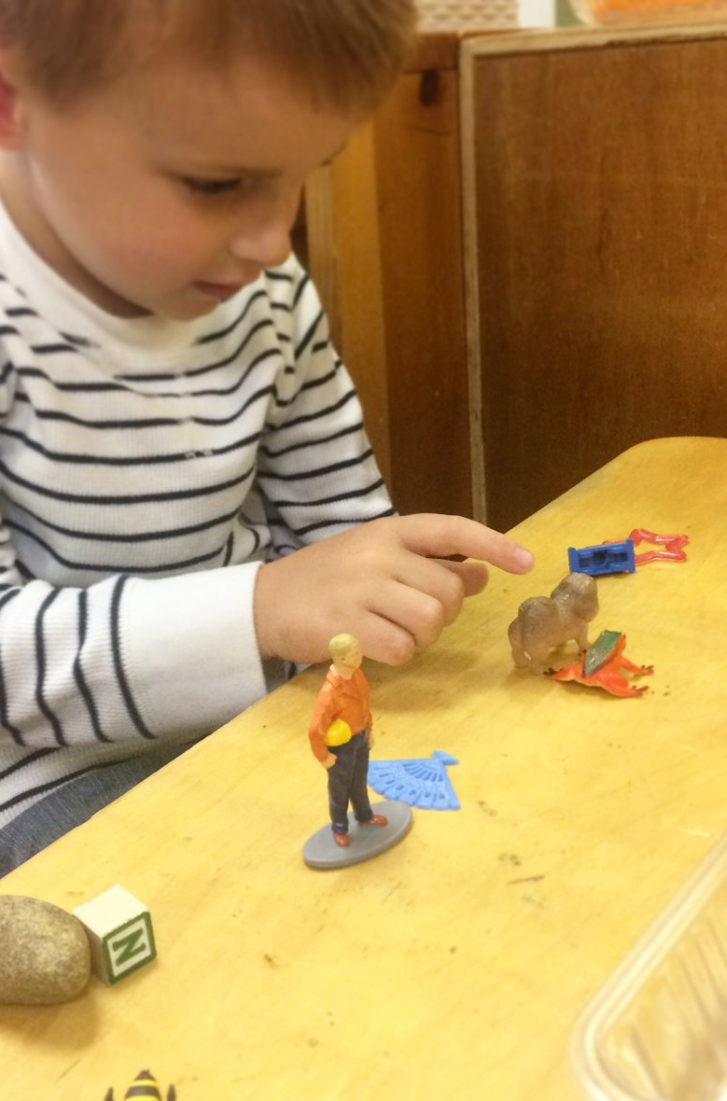
How?
Talki teaches vocabulary by requesting toys. It tracks the response to the requests. How often was it correct/incorrect. Thereby it’s possible to deduct what has been learned.
Talki teaches phonological awareness by speaking slowly & clearly, breaking words down and emphasising central phonemes and repeating them. There is no good way of tracking the progress of learning in this area.

Slide 16
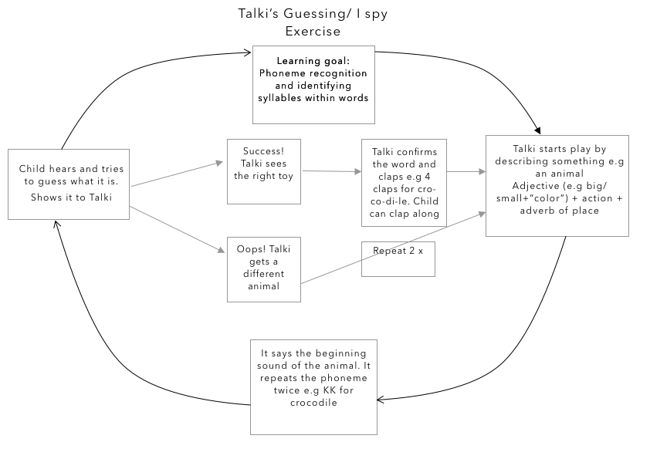

Slide 17
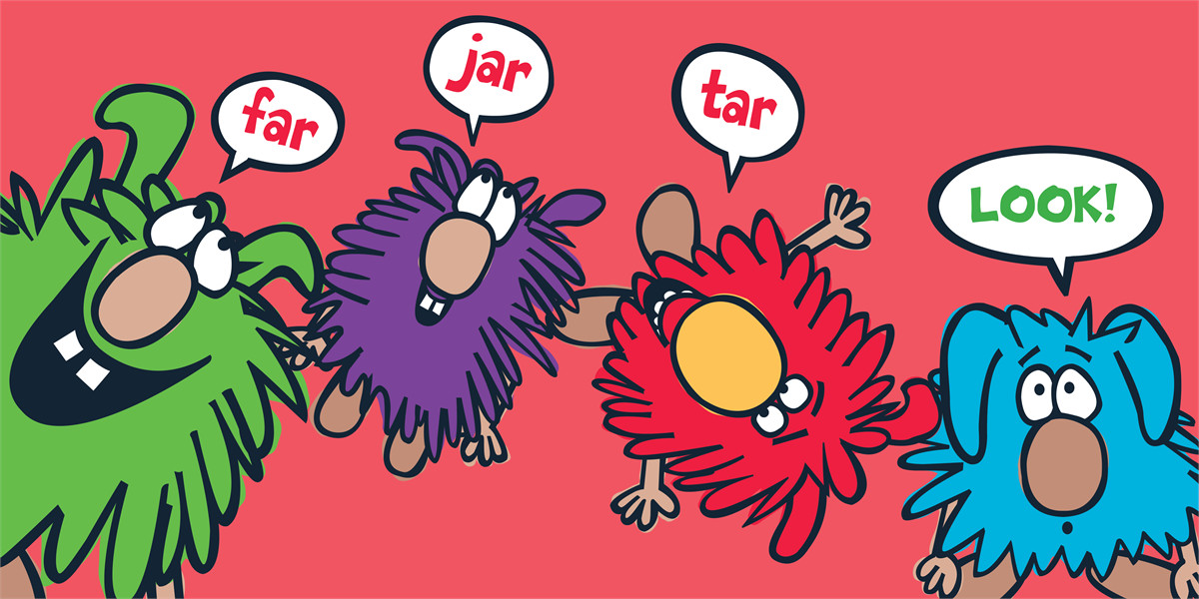
What teaching principles does Talki use?
Rhyming (learning that some words end with the same sound) e.g knock knock, it’s play o’clock or Ding-Dong let’s sing a song!!!

Slide 18
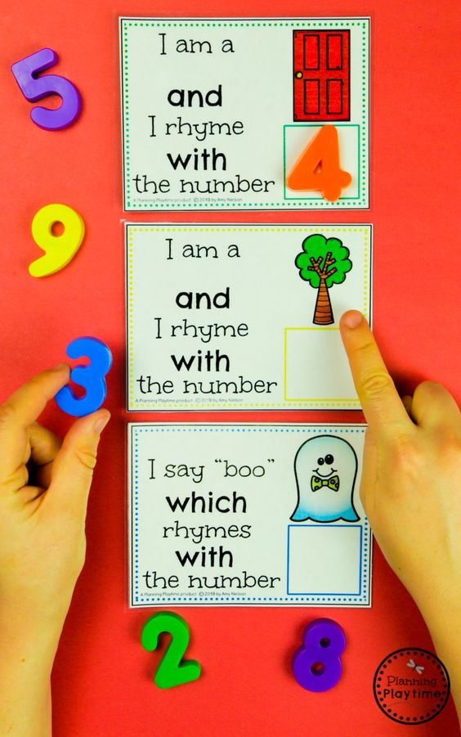
What teaching principle does Talki use?
Rhyming (learning that some words end with the same sound) e.g knock knock, it’s play o’clock or Ding-Dong let’s sing a song!!!

Slide 19
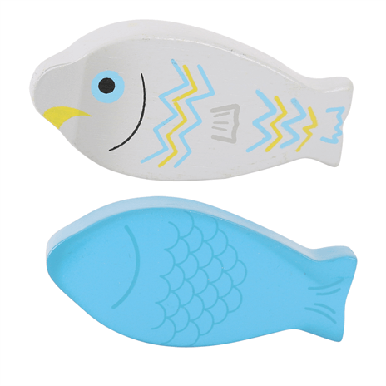
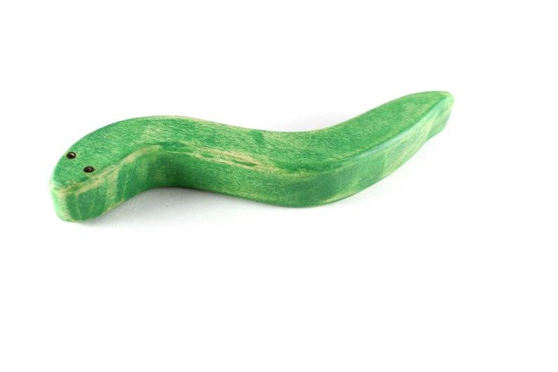
What teaching principles does Talki use?
Repeating the beginning sounds of a word e.g FFFF for fish or SSSSS for snake
FFFF
SSSSS

Slide 20
What teaching principles does Talki use?
Reinforcing sound recognition by repeating same sounds in different parts of the sentence e.g when Talki confirms what the toy is makes sentences with that sound “the snake is in the grass and it says SSSS” or “flip your fin funny fish”
FFFF
SSSSS

Slide 21
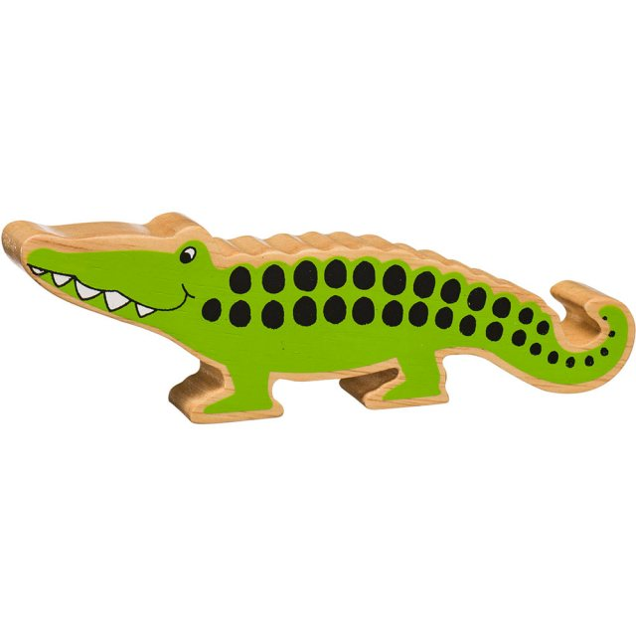
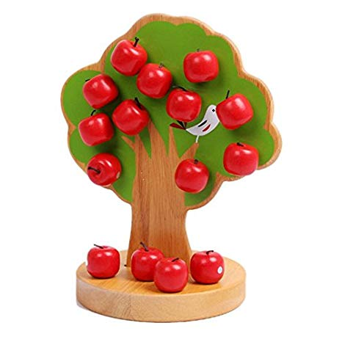
What teaching principles does Talki use?
Learning that words can be broken apart into syllables. Children can hear clapping out the syllables within a word and can clap together e.g three claps for e-le-phant , three claps for ba-na-na, 1 clap for tree or four claps for crocodile
4 claps for cro-co-di-le
1 clap for tree

Slide 22
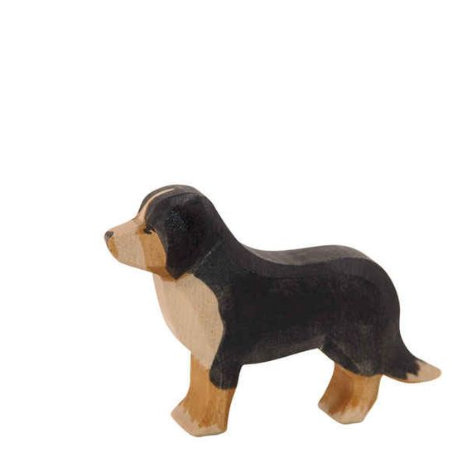
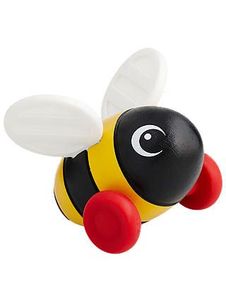
What teaching principles does it use?
Associating sounds to words, things or actions e.g Moooo Mooo is associated with a cow, bzzz bzzz to a bee, vroom vroom to a car, woo woo to a train etc
Bzzzzzzz
Woof woof

Slide 23
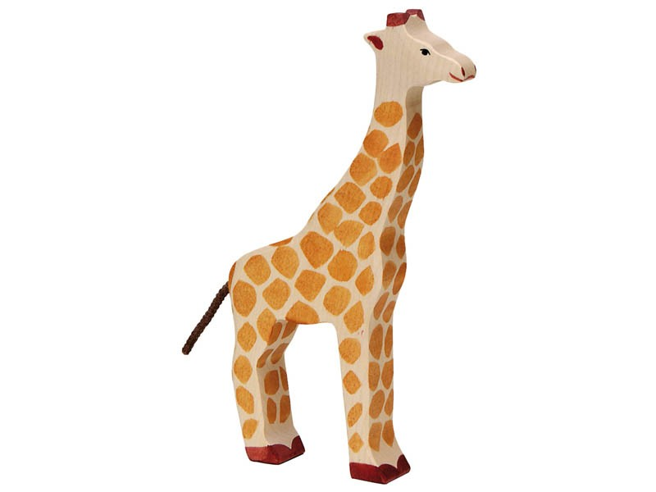

What teaching principles does it use?
Using voice pitch and exaggeration to describe things and concepts e.g A biiiiiiiiiig elephant or a taaaaalll giraffe

Slide 24
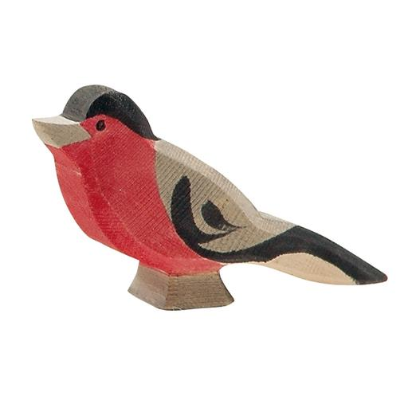
What teaching principles does it use?
Putting things in context
Giving clues about color, location, sounds or actions. As children start to understand and recognise isolated words, they can associate characteristics to toys e.g “I spy with my little eye something swimming in the pond. It’s a FFFF” or “I spy with my little eye something singing tweet tweet on the tree…It’s a BBB”

Slide 25






How does Talki give feedback?
Talki doesn’t reward children or says they are wrong. It doesn’t penalise children from making mistakes
Children get as many chances as they need to find the right answer
Talki gives feedback using interjections which are expressions to show emotion, surprise or excite e.g when a child brings the wrong object is says “uh-oh” or “oops” in a way that doesn’t express disappointment or sadness but emotional enough to be clear.

Slide 26
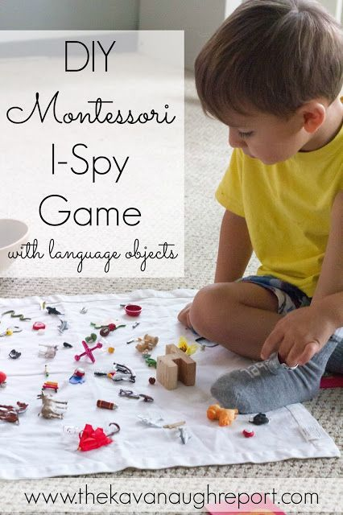
What activities can be played with Talki?
Exercises are based on traditional classroom activities for training listening, vocabulary recognition and phonological awareness
Talki’s methodology encourages exploratory play by:
Giving the child as many chances as they need to find the right answer
No time pressure

Slide 27
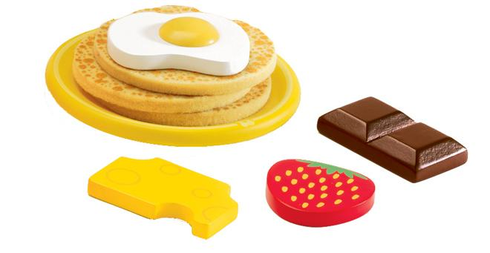
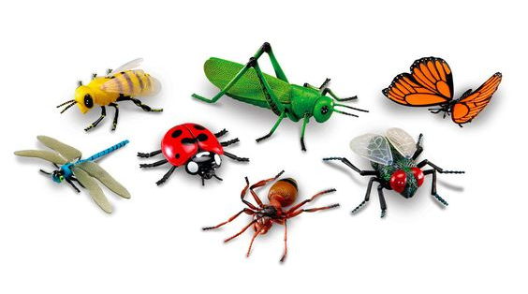
Exercise one
Feed me!! I am a monster I eat anything, like food, bugs and shapes
Learning goals: Reinforce phonological awareness through listening and recognising sounds within words
Talki asks: I’m hungry!!! I want a chhh chhh chocolate! Can you bring a chocolate?
Talki confirms: Thank you!!! chhh chhh chocolate is yummiii
Talki denies: uh-oh that’s a banana! Can you give me a chhh chhh chocolate?

Slide 28

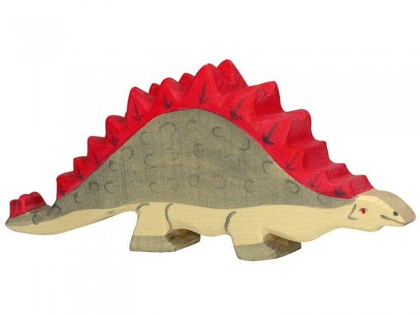
Exercise two
Guessing exercise…. I spy with my little eye/help me find something + clapping out the syllables
Learning goals: Reinforce phonological awareness through listening and recognising sounds + syllables within words
Talki says: I spy with my little eye something biiiiiiig from long ago! Can you see it? It’s a DDD dinosaur. Di-no-ssaur (3 claps). Where are you dinosaur?

Slide 29
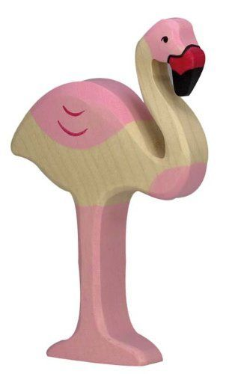
Talki says: I spy with my little eye something pink in the lake with very looooong legs. Can you see it? It’s a FFF flamingo. Where are you flamingo?

Slide 30
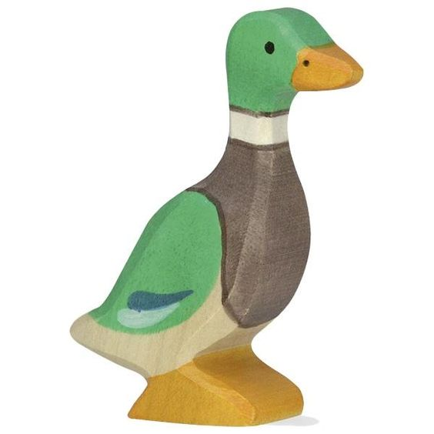
Talki says: I spy with my little eye something in the pond that says quack quack! What is it?
Confirming: Yeyyy, it’s a DDD Duck. Duck (1 clap)

Slide 31
Talki’s State Machine Diagram
Child not seen (no motion) for 5 minutes from any stage
Waiting for child
Face seen
Talki starts talking: “Peekaboo I see you! Hello I found you!”
Someone is there
No face seen for 5 seconds
Wait 5 seconds
If
I start a conversation e.g “bbbb banana. Can you give me a banana?”
Someone there waiting for me to talk
I want something, someone there
I ask for something
I want something, someone there
I got a different thing. I got a cake instead.
I deny: “Uh-oh!! This is a cake!! Can I get a banana?”
Goes back to repeating
Success!! I got the thing I’ve asked for (banana).
I confirm: e.g “Thank you!!! I love banana, banana is yummiiii

Slide 32
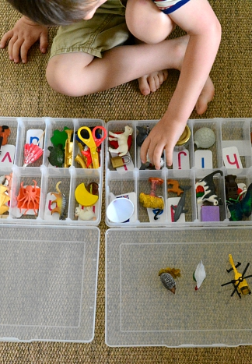
Learnings and User Testing Summary
Participants
Kindergardeners and preschoolers aged 3-6. They are all currently learning a second language or come from bilingual families
Research techniques
Field studies
Expert reviews

Slide 33
Learnings and User Testing Summary
Findings
Children were very physical with Talki. First reaction was to pull the ears.
Tried to be creative with the mouth, by putting other things e.g a full arm
Were attentively listening to the toy speaking
Picked different toys to see a reaction from Talki.
Did not understand full sentence but could understand isolated words e.g understood black but picked different animal
Showing Talki a toy wasn’t intuitive but when told toy could see, associated
Hypothesis
Children will be very physical with Talki (pull ears, hug it etc)
Will be curious after learning the toy speaks
Will not know how to show Talki an object, unless told how to by an adult
Will repeat attempts to pick the right object 10+ times (patient/persistent)

Slide 34

Promotional Video

Slide 35
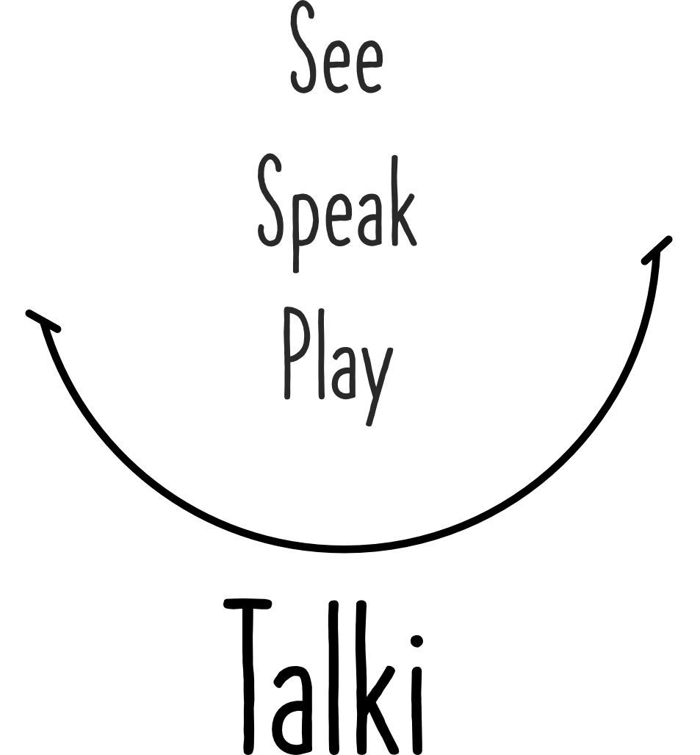

Slide 36
Thank you!

